Slide 1
pocketCampus
An application to enhance your university experience

Slide 2
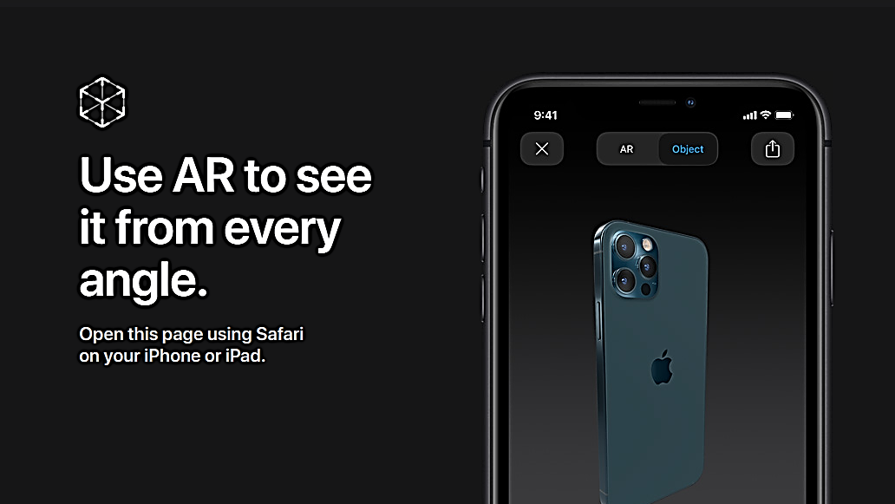



pocketCampus
Make your everyday university life easier with pocketCampus
A user friendly application which brings you:
University forums
Private Messaging capabilities
The latest news and events at UQ
The next bus times

Slide 3



Dashboard
pocketCampus
Application

Slide 4

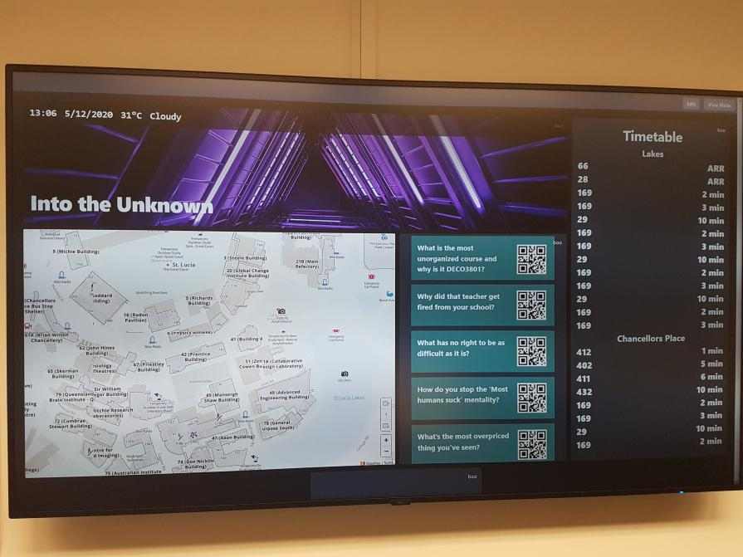
pocketCampus - Dashboard
It is customizable and configurable for the site admin
This means they can have different layouts for different screens

Slide 5


pocketCampus - Events
See the latest events happening at UQ
Explore university news with ease
Find out what the new hotspots are

Slide 6

pocketCampus - Navigation
Navigate through university with ease
Our information board allows users to map their journey on a large screen

Slide 7

pocketCampus – Bus Timetables
Get the latest bus times for both UQ Lakes and Chancellors Place stops

Slide 8
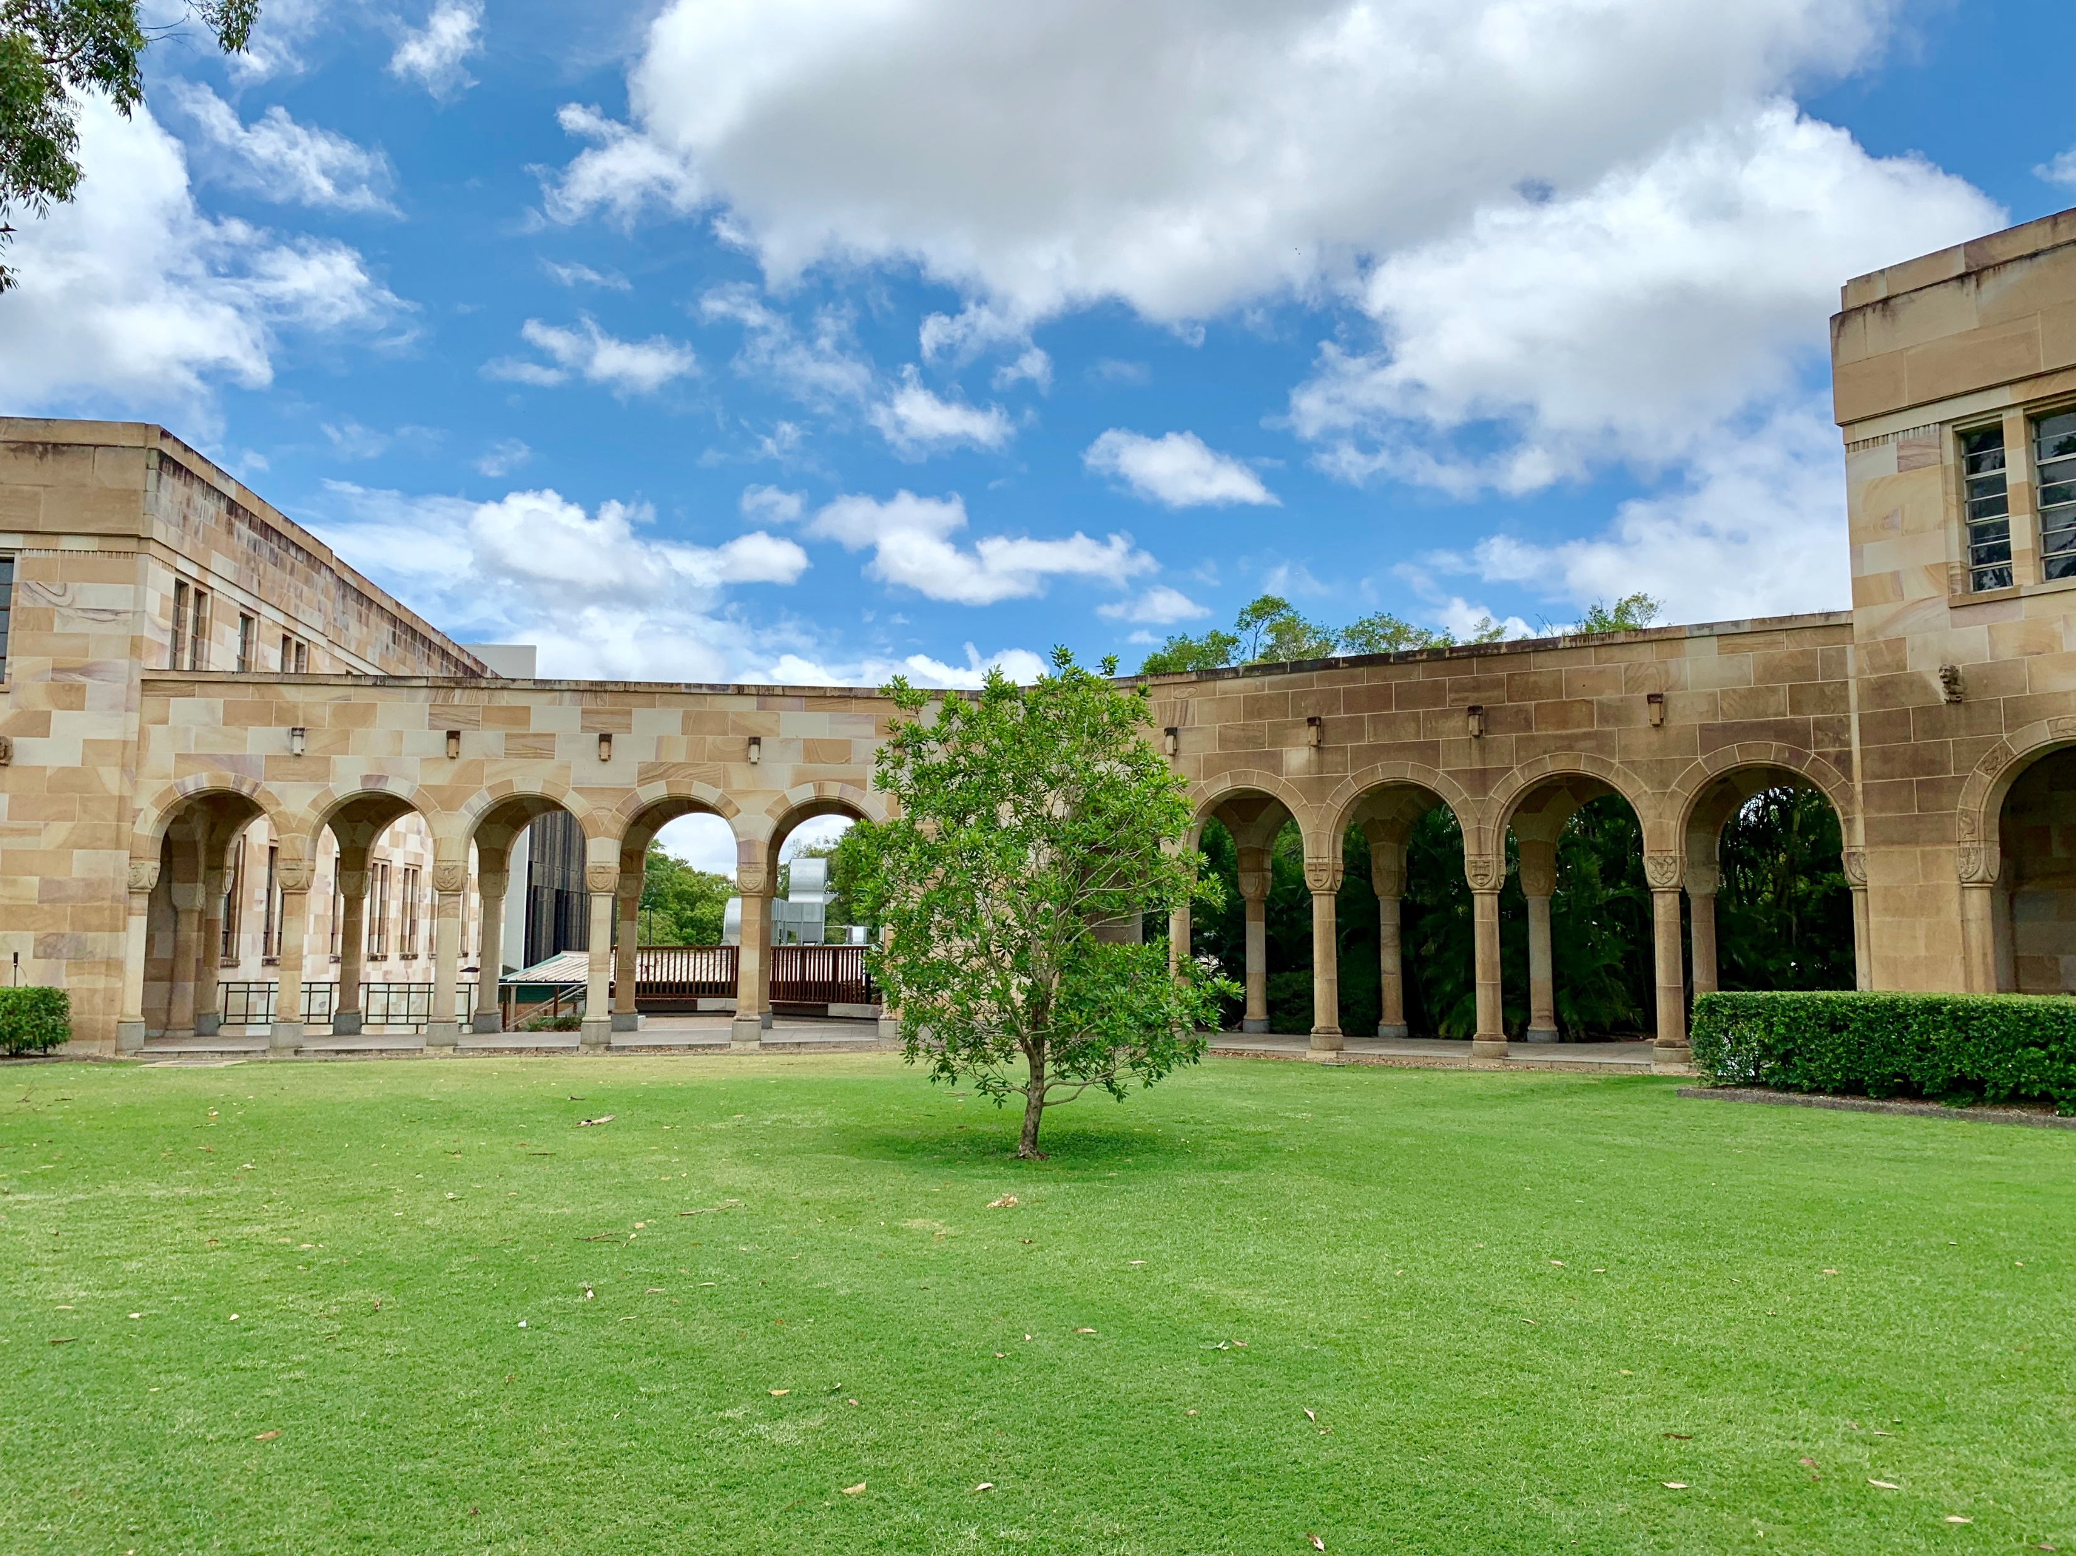
Our product takes information from TransLink's API to give students the latest bus times.
Our product takes information from Google Maps’ API to make UQ Map super accessible.
pocketCampus
Our product also displays weather information
Have the campus in your pocket

Slide 9
pocketCampus - Dashboard
SLIDE DEDICATED FOR SHOWING THE DASHBOARD FUNCTIONALITY MENTIONED BEFORE THIS SLIDE

Slide 10
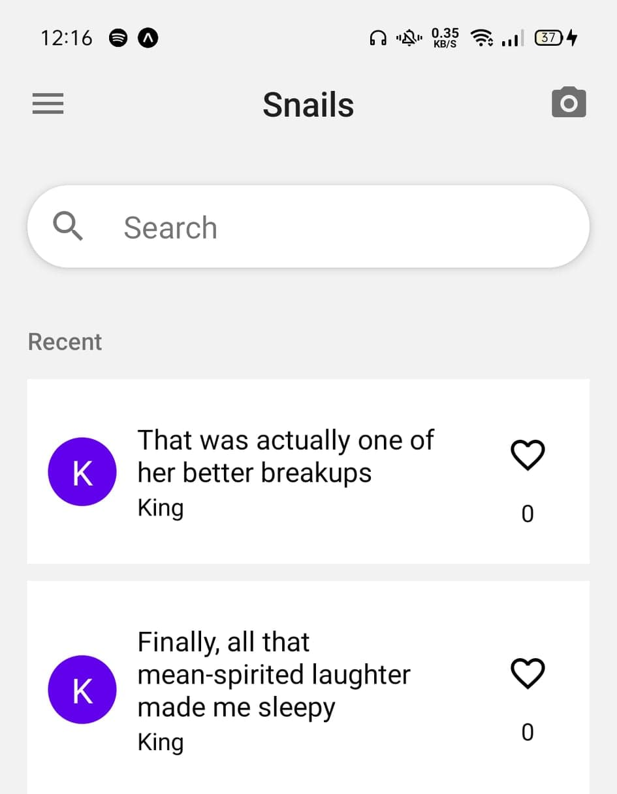

pocketCampus App
Have the campus in your pocket
pocketCampus
It’s the only app you need on your phone for university life!

Slide 11
pocketCampus – App Demo/gif
SLIDE DEDICATED FOR SHOWING THE APP FUNCTIONALITY MENTIONED BEFORE THIS SLIDE

Slide 12

pocketCampus
– Stay connected
Private messaging capabilities
Students can post on a forum through the app
The app connects with the information boards around campus and displays user posts

Slide 13
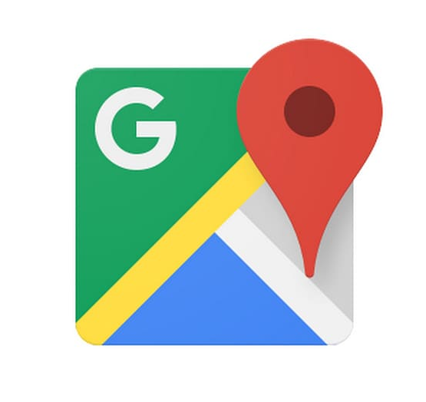



pocketCampus
Comparison to other applications
pocketCampus has the essence of other these other app with a focus for university life for students at UQ
No other products on the market like this one!

Slide 14

pocketCampus
Here at the Snails, we care about your privacy and that’s why private message will stay private.
The board does not save your data once you finish with using it. Only, saves posts which people wish to upload

Slide 15

pocketCampus – Authentication and
The app also requires authentication through student IDs and passwords that students use for blackboard.
As a group of students, we want our app to enhance the experience of future university students and also further improve our product.

Slide 16
pocketCampus
A product for the future

